Slide 1
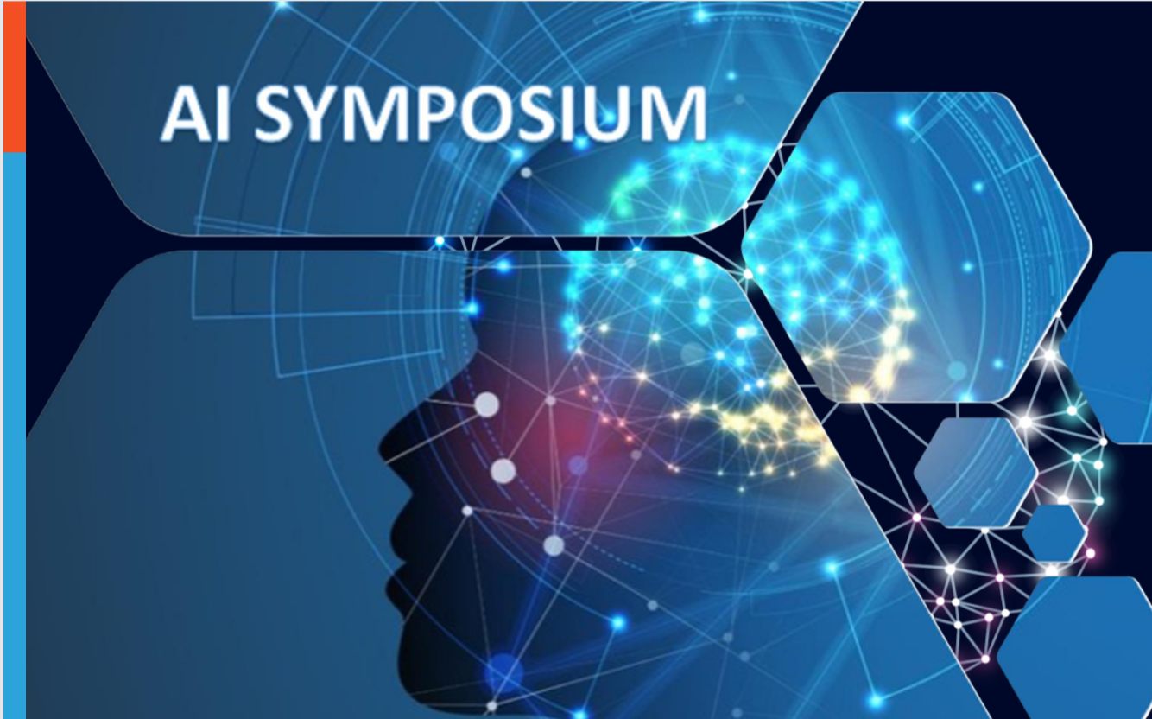
A gentle introduction to reinforcement learning
John Mark Agosta
24 June 2019

Slide 2
Goal: Introduce you to the flourishing field of Reinforcement Learning
Current excitement:
Deep Mind’s Alpha-Go success
Explaining Reinforcement Learning:
RL compared to Supervised Machine Learning
Application examples
Computation & Program Flow for RL algorithms
Two pass algorithms
“Actor – Critic”
MDP
Notebook Examples
Personalization example
Context, unobservable belief state
Demo of Azure Personalizer
Navigation example
- maze representation
- function approximation
RL & Deep Learning
Other Sources
…how to run the repository notebooks

Slide 3
What is RL?
RL expands on statistical machine learning to include outcome values, in sequential models with feedback.
“Episodic” learning by “trail & evaluation”
Think of learning a control or policy function.

Slide 4
Domains where RL is applied
Process control (think “robots”)
Use sensor feedback to learn a control function (a policy)
AutoScale: Dynamic resource optimization
Adjust capacity using current levels to predict future needs.
“Bandit” problems
Learn the best choice of advertisements to display.
Dialog systems
“Chatbots”
Personalized recommendations
Recommend items based on a person’s previous purchases

Slide 5
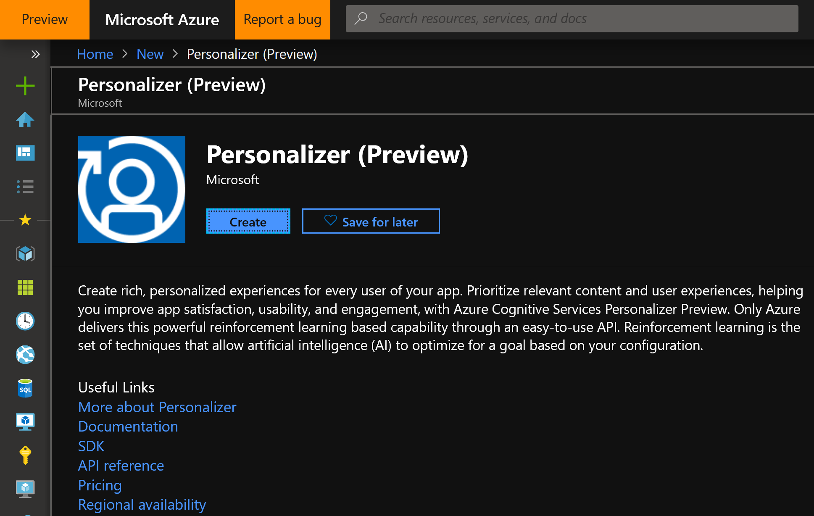

Slide 6
Supervised Machine Learning uses labels to learn to predict from features
Predict
Current features
Prediction
Model
Train
Historic features
Data labels

Slide 7
Reinforcement Learning computational components, in comparison, includes explicit rewards & actions.
Supervised Machine Learning
Current data
Predict
Prediction
Model
Historic data
Train
Data labels
Observed features
Agent
Action
Policy
Environment
State features
reward

Slide 8
A Markov Decision Process (MDP) view of a Reinforcement Learning model consists of state, actions, and rewards (values).
S
S
S
S
S
C
a
a
a
a
r
r
r
r
r
stage t
RL is the problem of controlling a Markov Chain with unknown probabilities.

Slide 9
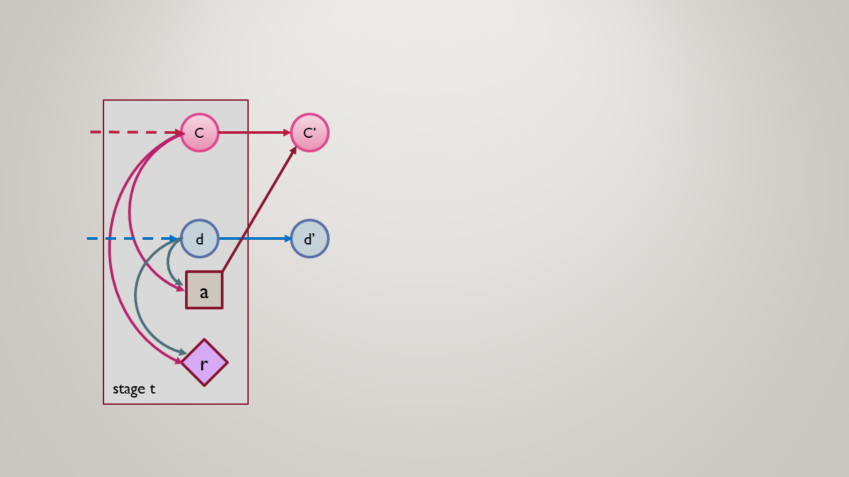
Example: Autoscale Dynamic Provisioning: Matching Real-time traffic demand with cluster capacity
c – cluster capacity
d – connection demand
a – scaling actions
r – overprovision /
lost traffic tradeoff

Slide 10
Aspects of RL
Underlying Markov Decision Process – Solutions borrow from Dynamic Programming
Model-free solutions: Sampling from the environment takes the place of knowing the MDP state transition probability matrices.
“Credit Assignment” Rewards don’t necessarily occur when actions are taken
“Temporal Difference” learning. Iterative methods based on limited look-ahead.
Function Approximation for continuous state spaces & generalization
Exploration – Exploitation tradeoff. Take time to discover unexplored, possibly improved states and actions.

Slide 11
Multi-pass solution methods
Start
state
Goal
state
State sequence
Policy Evaluation (backing up through time)
Policy improvement (optimize actions, unfolds forward)

Slide 12
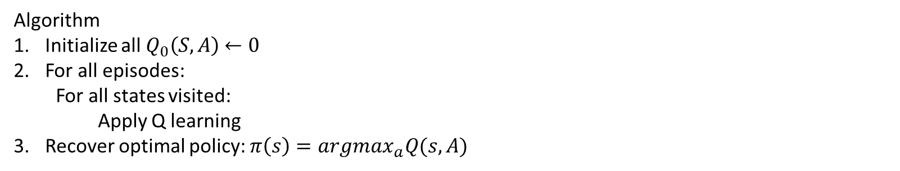
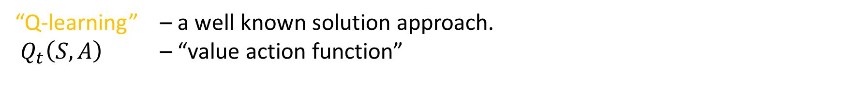
The current class of solution methods alternate Policy Evaluation and Improvement – this is called “General Policy Iteration.”
“Q-learning” – a well known solution approach.
$Q_{t}\left(S,A\right)$ – “value action function”
$$Q_{t+1}\left(S, A\right)←Q_{t}\left(S,A\right)+α[r\left(S,A\right)+\max_{a}^{′}{Q_{t}\left(S^{′}, A^{′}\right)−Q_{t}(S,A)]}$$
Algorithm
Initialize all $Q_{0}\left(S,A\right)$ $←0$
For all episodes:
For all states visited:
Apply Q learning
Recover optimal policy: $π\left(s\right)=argmax_{a}Q(s, A)$

Slide 13
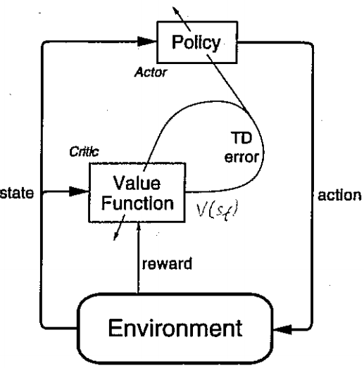
In an Actor-Critic algorithm, the Actor aims to improve the current policy based on the current value function, and the Critic improves the value based on the rewards generated by the current policy. Together they implement Generalized Policy Iteration, trying to converge on optimal value and policy functions.
Actor
“Temporal Difference (TD) =
Reward prediction error
Critic

Slide 14
Demo
Maze Navigation

Slide 15
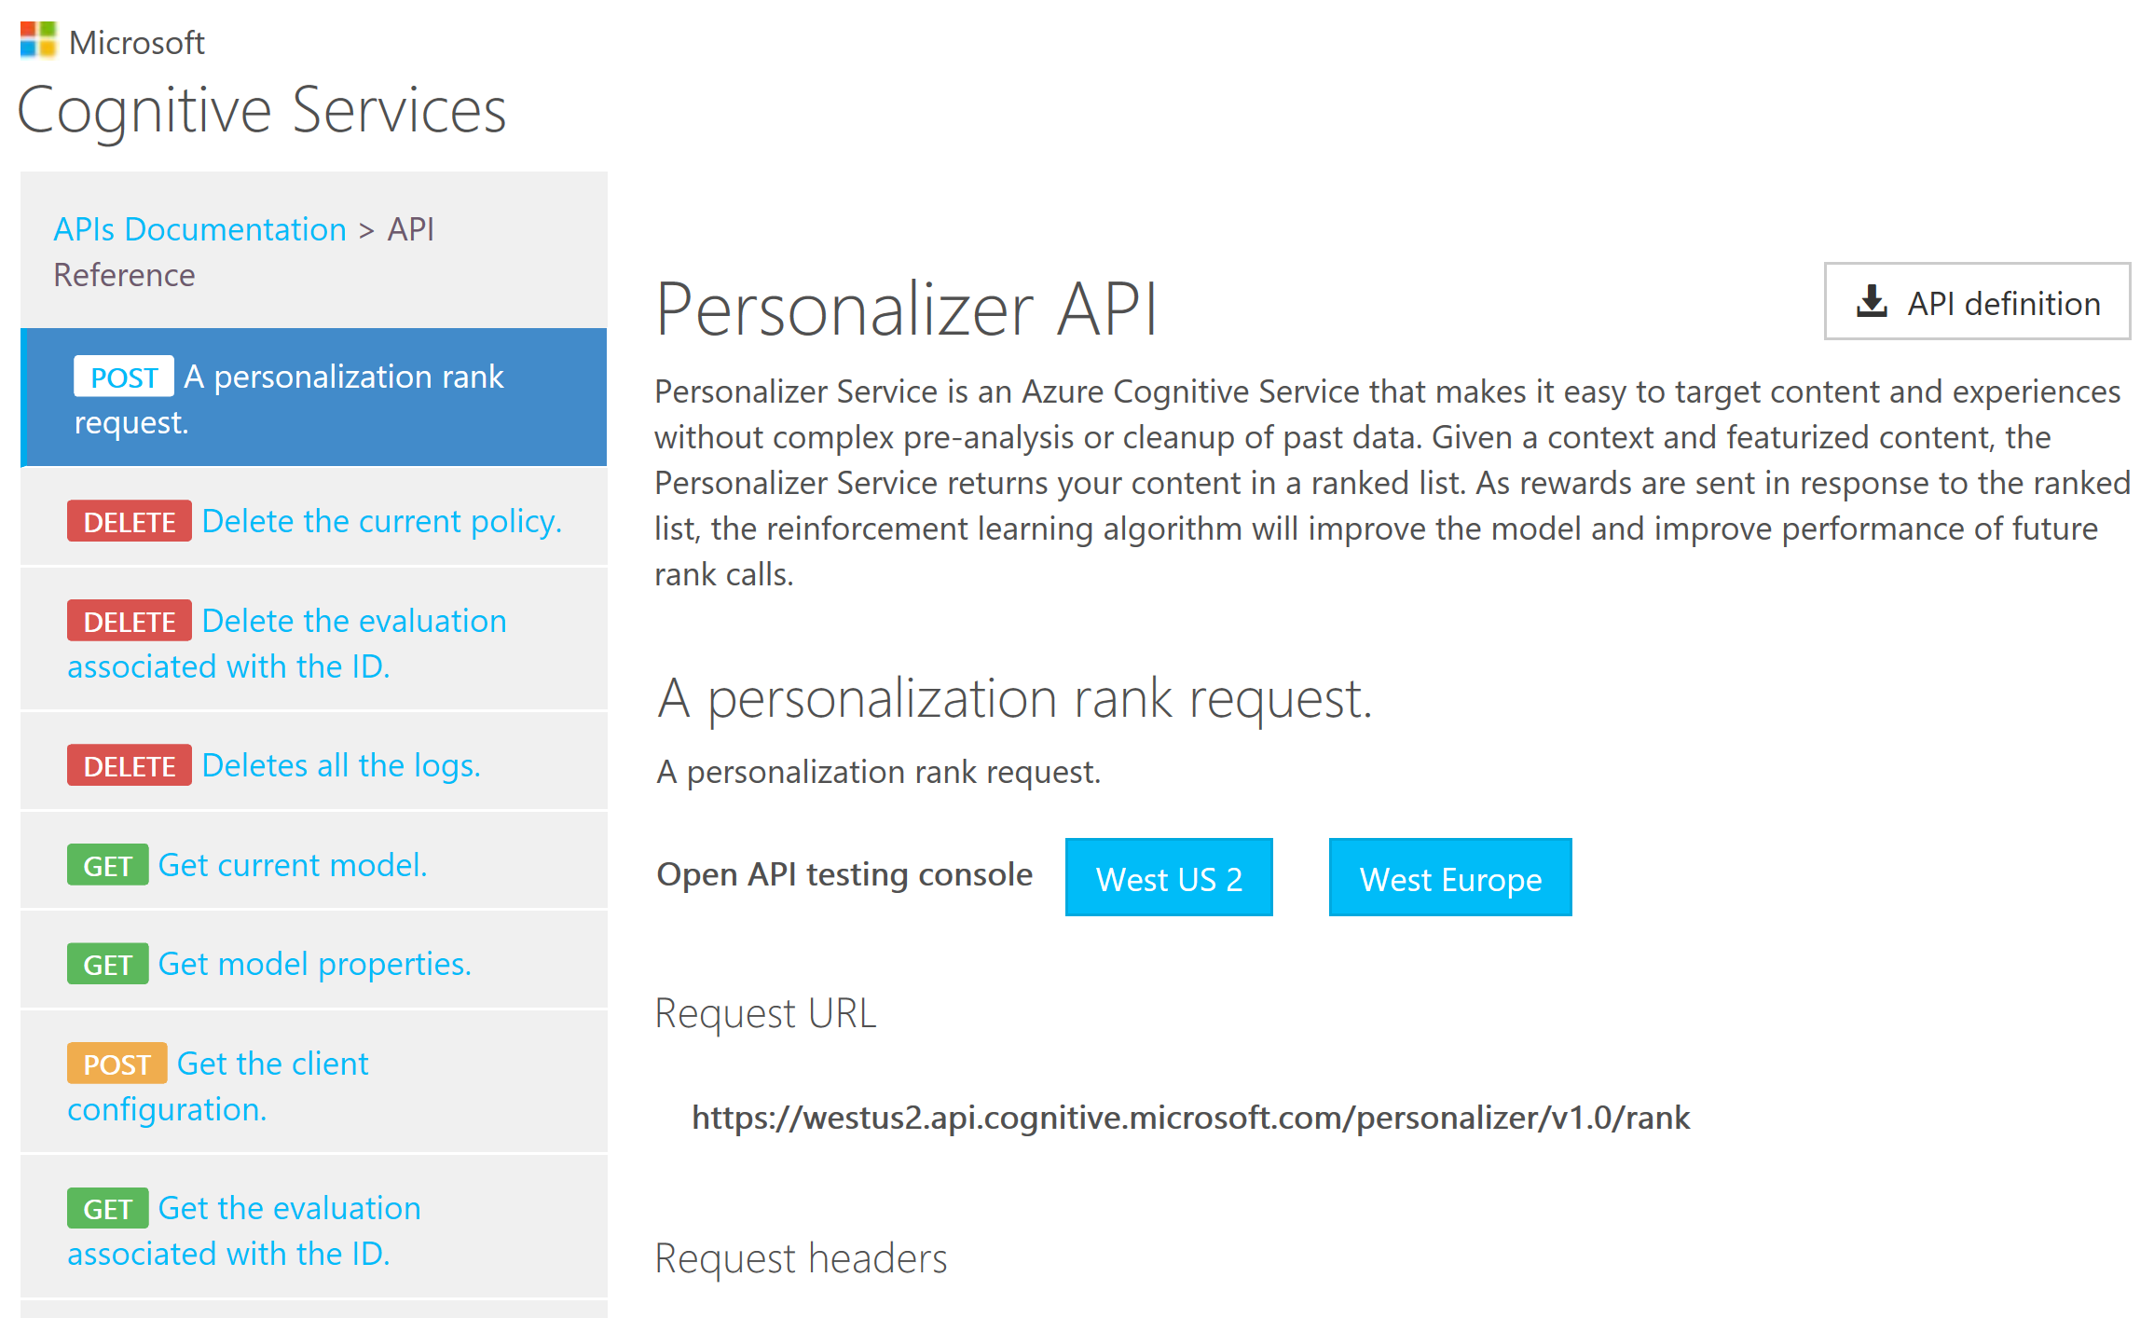

Slide 16






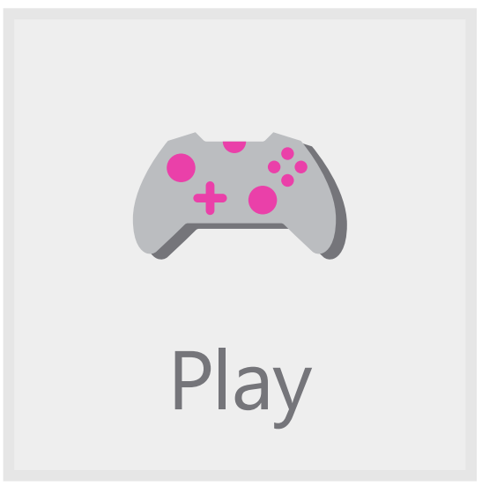

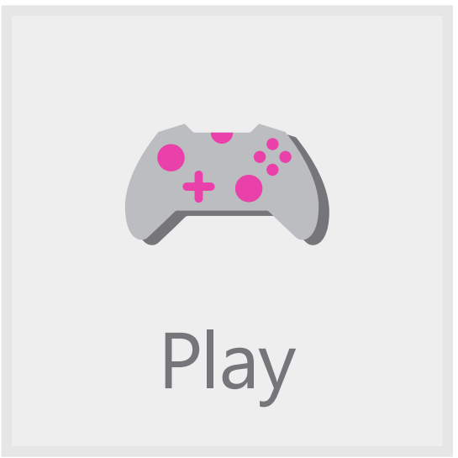










Example
Your App
User & Context Info
Have Fun!
We think you’ll like…
Action 1 info
?
Action 2 Info
Rank(..)
Personalizer Service
Reward(r)
Your Users
Action 3 Info
Your evaluation of the observed user behavior
Reward Score
Notes:
Use icons from EB animation

Slide 17



Discovering Patterns & Causality
Exploit for performance
“Exploit”= use best known inference
“How much should I explore to discover how to best perform?”
x%
Policy
Explore to discover new things
“Explore” = try other alternatives

Slide 18

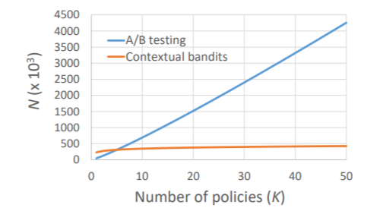
A/B Testing vs. Offline Experimentation
A
Exploit best known inference
👍👍👍👍👍
[0.8]
Collect Reward & User Interactions
Exploration Policy
B
Explore new alternatives
A/B Test:
Design the Right Experiment,
Test online once, Get data once
Start over
Offline Experimentation:
Use models that exploit and explore
Record User Interaction
Find the policy and model that fits reality
With Cognitive Services Personalizer:
Run 1000s tests/day/person or more
Find new levels of performance that can’t be found with A/B testing ..O(n) vs O(log n)

Slide 19
RWRL system
Decision Service
Your
App
FrontEnd
-or-
ClientLib
Joiner
Storage
Online Trainer
Request Decision
Actions, Features
Actions, Features, Probabilities, EventId
Decision Action, EventId
Experimental
Unit Duration
Report outcome Reward, EventId
Reward, EventId
Actions, Features, Prob. Reward, EventId
Actions, Features, Prob. Reward, EventId
New
Model

Slide 20
Origins of RL
”reinforcement learning can be viewed as a microcosm for the entire AI problem” - Russell & Norvig 2009
Early work in neuroscience’s “law of effect”
Samuels Checkers player (1959)
Tesauro “TD-Blackgammon” (1992)
Sutton and Barto (1998).
“Deep RL” (2014)
See Andrew G. Barto (2019) “Reinforcement Learning: Connections, Surprises, Challenges”, AI Magazine, vol 40:1, pp 3-16.

Slide 21
Current progress
RL’s sampling-based (“Monty-Carlo”), model-free approaches scale to environments with huge state spaces, not practical with MDP approaches.
Notable Advances in Deep RL:¹
”Deep-Q Network” (DQN) (Mnih et al., 2015), applied to video games.
AlphaGo (Silver et al., 2016a; 2017), used for Deep-Mind’s Go-Playing programs.
DeepStack (Moravˇcik et al., 2017) for imperfect information games.
Deep Mind reduces Data Centre Cooling Bill by 40%.²
Simulated robot motion, see https://youtu.be/gn4nRCC9TwQ
Commercial applications, Startups: http://Bons.ai
1. YuxiLi(yuxili@gmail.com), “DEEP REINFORCEMENT LEARNING”, arXiv:1810.06339v1 (15 Oct 2018).
2. https://deepmind.com/blog/deepmind-ai-reduces-google-data-centre-cooling-bill-40/

Slide 22
Sources
OpenAI: https://openai.com/
Pybrain: http://pybrain.org/
RL-glue: https://sites.google.com/a/rl-community.org/rl-glue/Home/rl-glue
LibPG: http://code.google.com/p/libpgrl
RISE lab’s rlLib: https://rise.cs.berkeley.edu/projects/rllib/

Slide 23
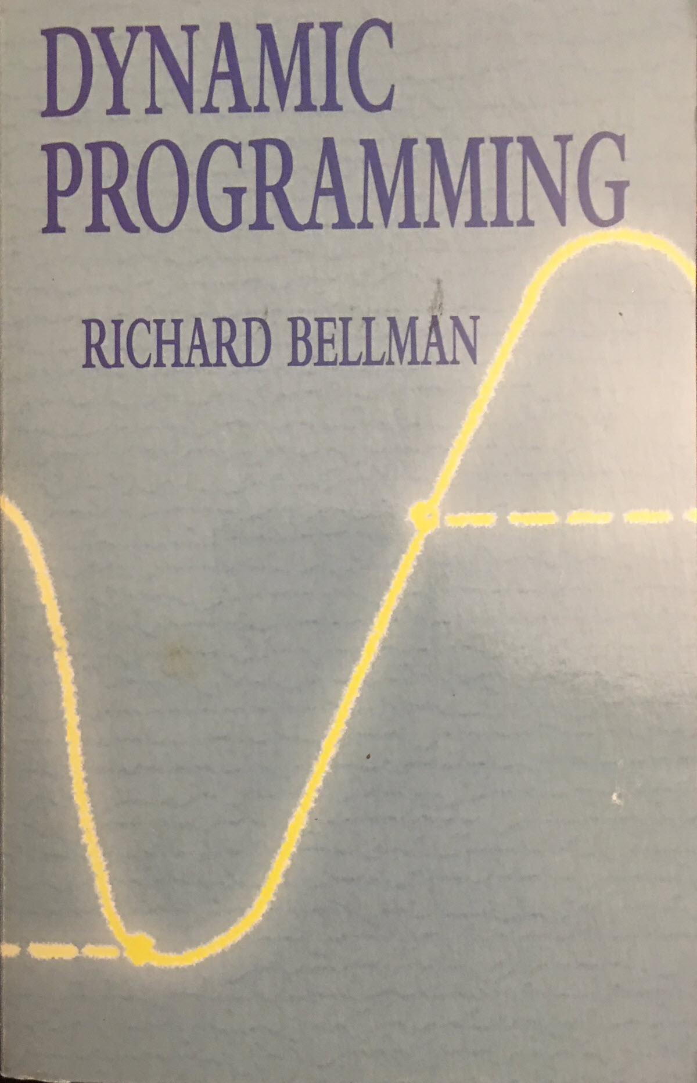
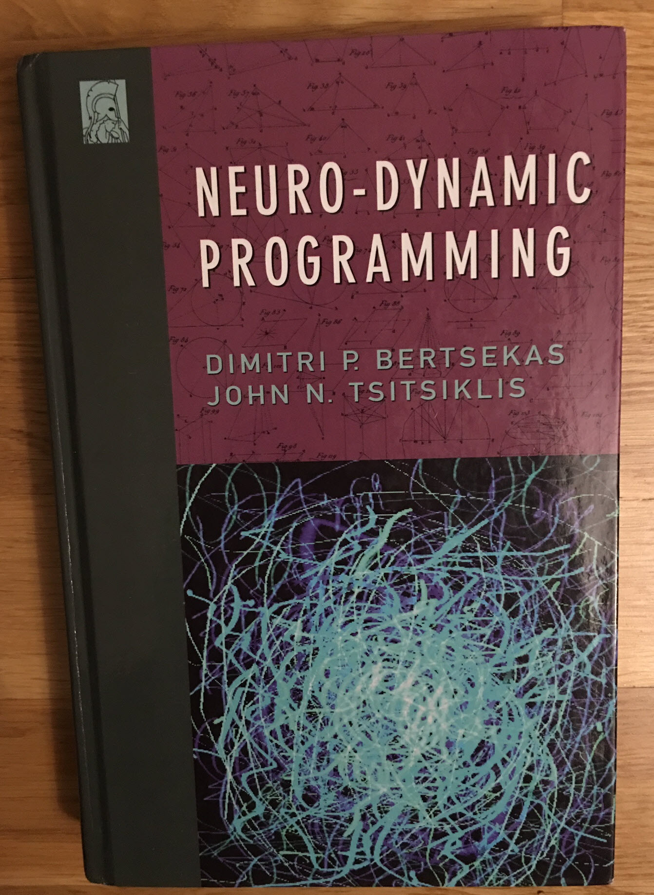
Recommended Books

Slide 24
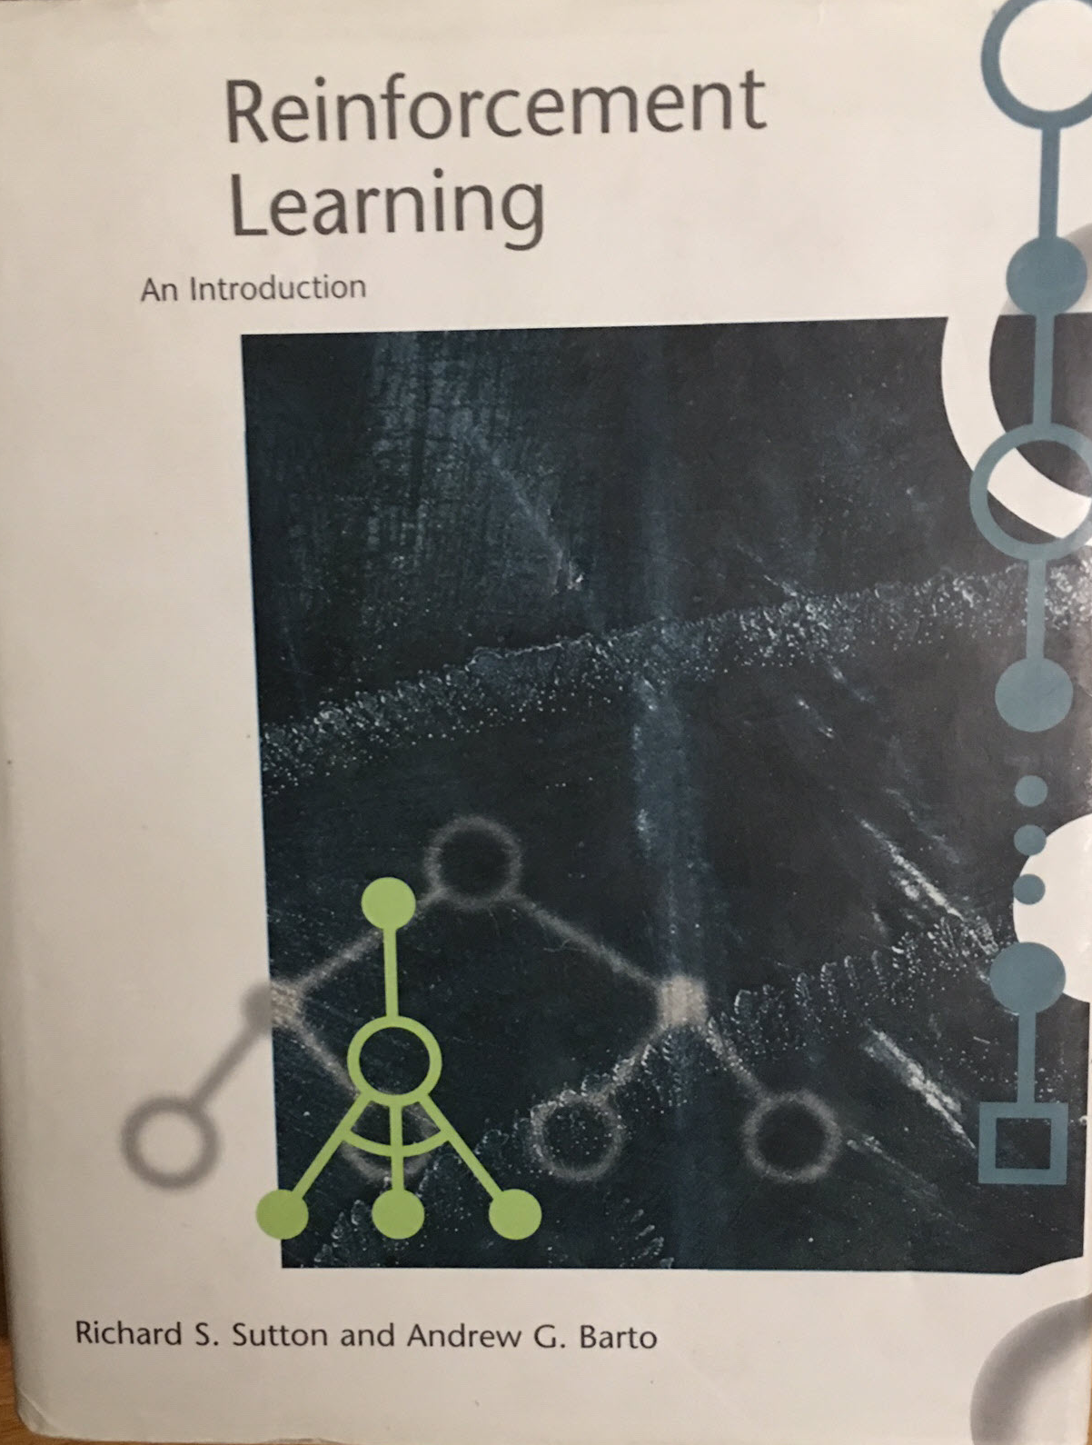
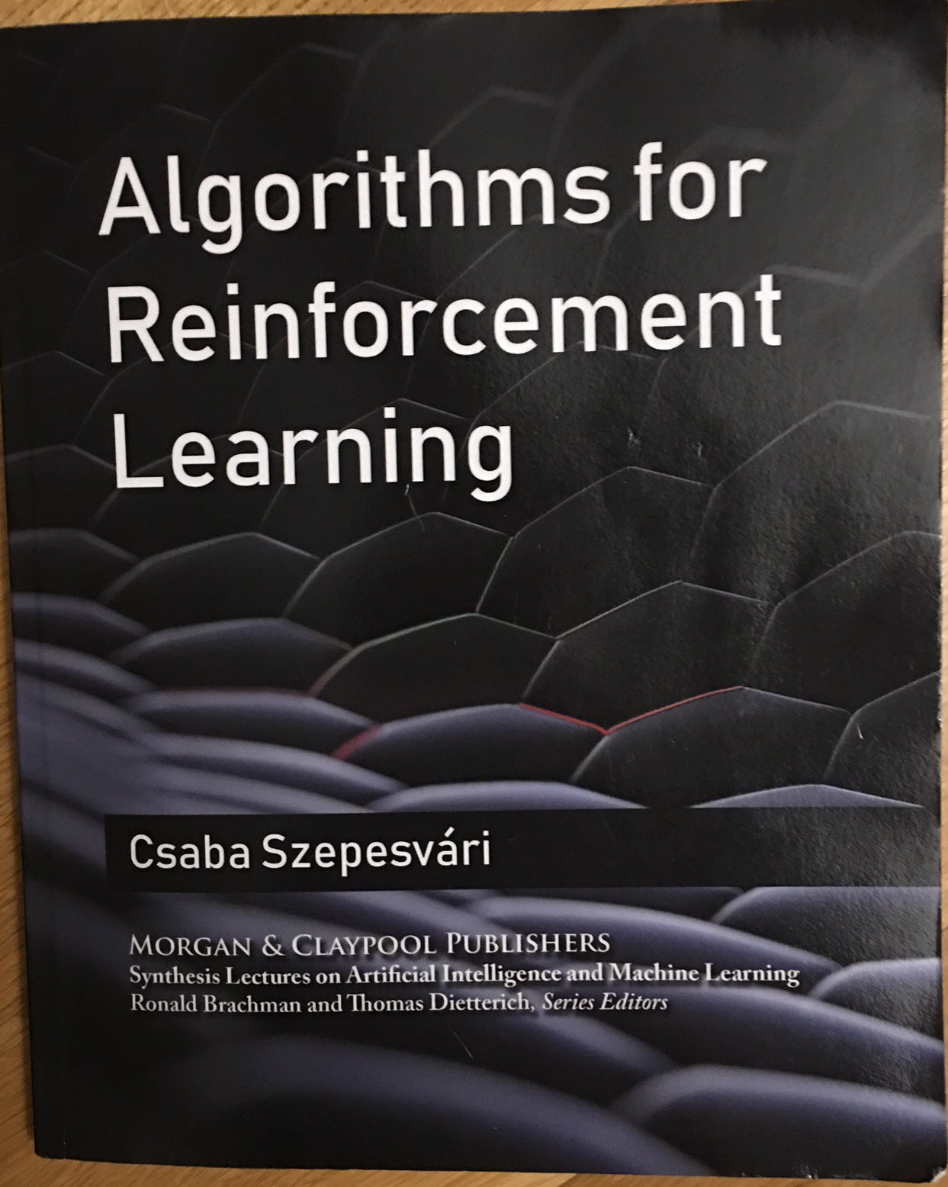

Slide 25
https://github.com/microsoft/ICSE2019
John-Mark.Agosta@Microsoft.com

Slide 26
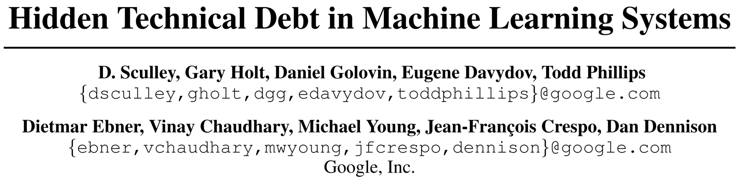
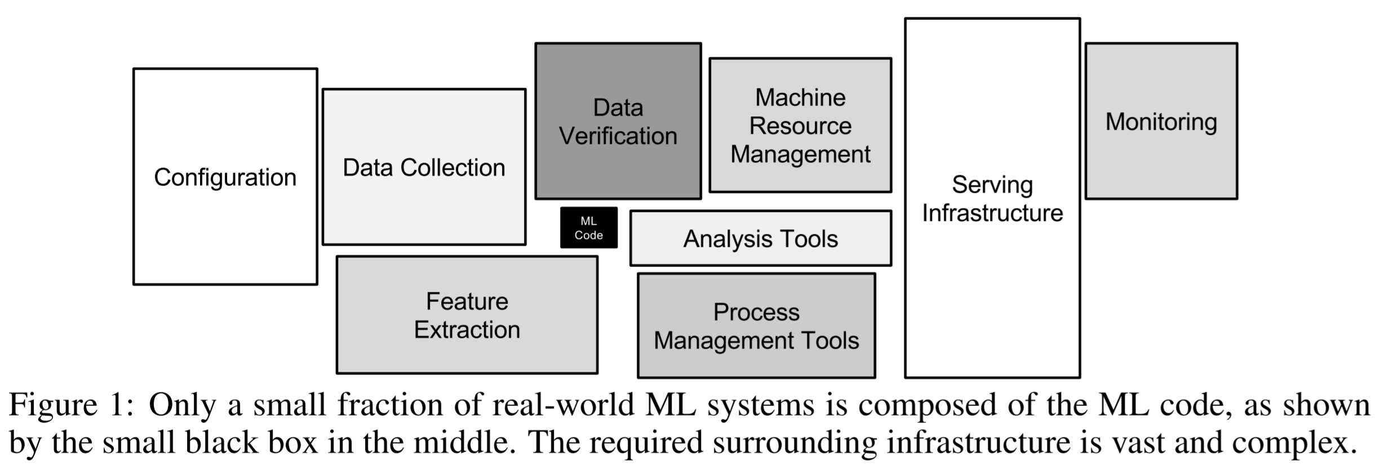
Notes:
ML code is just the little black box in the middle.

